Slide 1
The App Store Business Problem
July 16, 2020
Data Science Career Track
Springboard India

Slide 2
Overview
Our client is a company that designs operating systems, and they want to build a major apps store into their user interface. To this end, they want to know whether Google Play apps have higher reviews on average than Apple Store apps (or vice versa) , as they’re intending to strike a deal with just one of these companies.

Slide 3
Understanding the problem
Our client can only strike a deal with either one of Google or Apple. Their decision on which to choose will solely be based on App ratings on both platforms. So we only need to find out with confidence, which App store has the higher ratings out of 5 for apps on average.

Slide 4
Project objective:
To find which app store(Google vs Apple) has higher rated apps on average

Slide 5
Cleaning and Transforming Data
We had the datasets with the App Category, Rating, No. of Ratings and Price: + Google Play Store Apps (10841 items) + Apple Store Apps (11097 items)
The Apple dataset had healthy column datatypes.
In the Google dataset: + There was one App that had a non-workable ‘Price’ value and so it’s data-row was eliminated.
+ The ‘Price’ values had a ‘$’ symbol which was also eliminated.
+ The ‘Number of reviews’ column was changed from ‘Object’ type to ‘Integer’ type.

Slide 6
Cleaning and Transforming Data
+ A ‘platform’ column was added to both datasets to denote the platform of an app.
+ The column names of both datasets were matched and they were joined.
+ There were 18037 rows(Apps) then and 1474 rows were dropped because they had a NULL value.
+ A further 929 rows(Apps) were dropped because they didn’t have any reviews.
+ Then we had:
6268 Apple Apps from the original 11097 items
9366 Google Apps from the original 10841 items

Slide 7
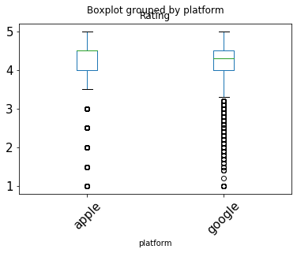
Cleaning and Transforming Data
+ The mean rating of the 6268 Apple Apps was 4.049697
+ The mean rating of the 9366 Google Apps was 4.191757
Google Apps had an Observed Difference of +0.14206 higher rating on average.

Slide 8
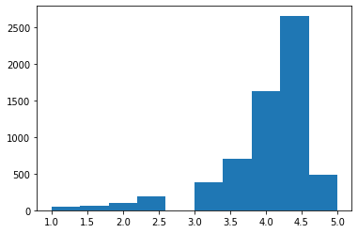
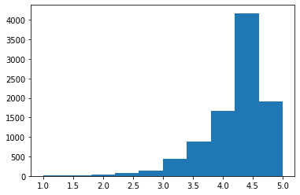
Modelling
We need to test if the observed difference is due to chance or due to platform
Apple Google
Data Distribution (Number of Apps vs Rating)
Both Datasets are not normally distributed.

Slide 9
Modelling
We’ll do a non-parametric Permutation Test to randomly shuffle the data to check if the observed difference is due to chance or actually due to platform.
1 permutation test yields the result:
Apple mean rating = 4.128398 (Observed = 4.049697)
Google mean rating = 4.139088 (Observed = 4.191757)
The difference in mean is now +0.01069 against the Observed Difference of +0.14206.
There is a significant difference!

Slide 10
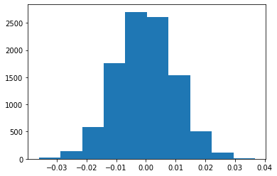
Modelling
The difference is significant and we’ll do 10000 permutation tests on the data.
The distribution of the result of the 10000 trials is shown below:
It is also found that none of the trials give a result that is at least as extreme as our Observed Difference of means (|0.14206|). Most differences are in the 0 - 0.02 range.
Number of trials vs Calculated difference of means

Slide 11
Result
Based on our statistical testing, most of the calculated Difference of means in 10000 trials is in the |0-0.02| range and not even one is atleast as extreme as our original Observed Difference of means where Google had +0.14206 better ratings.
Therefore, without regard to any significance level, we can conclude with full surety that the difference in means is not due to chance but actually due to platform difference!
Hence we can conclude that Platform does indeed affect ratings and that: Google Play Store has higher rated apps on average than Apple Store
We should advise our client to integrate only Google Play Store into their operating system interface and so, to strike a deal with Google.

Slide 12

Thank You
Harikrishnan V
Data Science Career Track Springboard India

